Slide 1

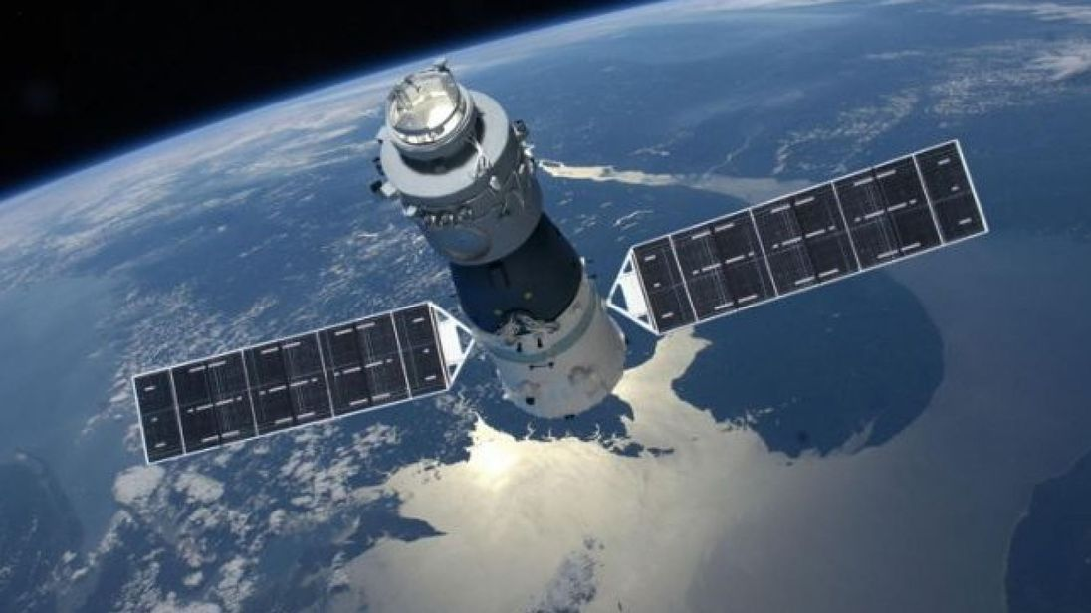



Recovery of the Tiangong 1 Spacecraft
Jacob Bailey
Gus Lee
Michael Lesnewski
INTRODUCTION
Maneuver Methodology
Results
Plots Continued
Background
The Chinese space station Tiangong 1 re-entered the Earth’s atmosphere and fell to its demise on April 2nd, 2018 over the South Pacific Ocean.
Project Objective:
Based on set of initial conditions ($R_{0},V_{0}),$ the space station’s orbit is to be propagated at least 30 days into the future. At which time an optimal maneuver is to be initiated in order to place the station back to its initial orbit and saving it from its demise.
The decayed and desired orbits were propagated for orbit each.
The true anomaly of the starting and end points were varied over the range of 0 to 2π.
The time of flight (TOF) between the points was varied over roughly 0 to 3 orbital periods (1.5 to 4.5 hours).
At each point in space, a set of initial and final position vectors are generated.
These vectors along with the time of flight are fed into a Lambert Solver (via Izzo and Lancaster, Blanchard & Gooding) to find the corresponding velocities to the arc between them.
The resulting velocities were subtracted from the orbital velocity at the corresponding point in the orbit:
${dV}_{1}= V_{1,Lambert}−V_{Decayed}$
${dV}_{2}= V_{2,Lambert}−V_{Desired}$
These impulsive delta velocities were stored, and the combination of their magnitudes were used as a cost function.
After searching over the entire design space, the search mesh was refined iteratively to enclose a smaller region of design space, until a suitable convergence was reached.
Minimum Burn Cost: 1.5639 km/s
Position for Burn One: 164.2874 4881.3597 4507.9203 km, ECI
Delta Velocity, Burn One: 1.3877 km/s
Position for Burn Two: -3659.0625 -3701.1149 -4166.2349 km, ECI
Delta Velocity, Burn Two: 0.1762 km/s
Time of Flight: 7622.0408 seconds
True Anomaly of First Burn: 1.5200 rad
True Anomaly of Second Burn: 2.1400 rad
Burn 1: 0.07323 0.88478 -1.06655 km/s, ECI
Burn 2: 0.00494 0.07557 -0.15914 km/s, ECI
Plots
Initial Conditions
The following plots show at which true anomaly of the starting point, ending point and time of flight the impulsive maneuver is at a minimum.
Keplerian Elements at epoch:
$\left[\begin{matrix}\begin{matrix}a \\ e \\ i\end{matrix} \\ \begin{matrix}Ω \\ ω \\ f\end{matrix}\end{matrix}\right]=\left[\begin{matrix}\begin{matrix}6657.392 \\ .002595 \\ 42.7480\end{matrix} \\ \begin{matrix}345.3259 \\ 124.4126 \\ 287.7186\end{matrix}\end{matrix}\right]$
Keplerian Elements after 55 days of decay:
$\left[\begin{matrix}\begin{matrix}a \\ e \\ i\end{matrix} \\ \begin{matrix}Ω \\ ω \\ f\end{matrix}\end{matrix}\right]=\left[\begin{matrix}\begin{matrix}6646.808 \\ .000887 \\ 42.775\end{matrix} \\ \begin{matrix}2.0344 \\ 0 \\ 2.3239\end{matrix}\end{matrix}\right]$
The 55 day decay period was chosen to allow the Earth’s oblateness perturbations to naturally align the space station closer to our final desired orbit, particularly with regards to $Ω$, which can necessitate a costly maneuver.
Software: How-to
Inputs:
Tiangong 1’s orbital elements and position/velocity after the decay period – this is the starting orbit
Tiangong 1’s original orbital elements before any decay – this is the desired final orbit
Outputs:
Total cost of the maneuvers (total ΔV)
Steps to use the software:
Run NumericalIntegration.py for the desired decay period to generate the Tiangong 1’s decayed orbital elements and position/velocity vectors.
The outputs generated from 1 and the satellite’s original orbital elements (our desired final condition) are used as inputs to Project3.m.
Project3.m uses these inputs to calculate the ΔV’s using the methodology described above.
Conclusions
An optimal recovery maneuver for the Chinese space station Tiangong 1 was investigated. Even though, recovery could have been initiated at the 30-day mark, it was found that waiting until the angle of ascending nodes aligned closer with our final desired orbit drastically reduced the required ΔV. Therefore, a decay period of 55 days was chosen. The optimal recovery maneuver had a burn cost of 1.5639 km/s. This is a significant improvement over the ΔV required at the 30-day mark, which was11.3130 km/s.

